Slide 1

Teacher's Portal
A Web Application for Teachers
TEAM MEMBERS
MOHIB ALI KHAN
AHMED GUL
IHSANULLAH

Slide 2
PROBLEM STATEMENT
Project Overview
Objectives
Digital platform to simplify and manage
teacher’s tasks.
Intuitive interface for teachers
Streamline class management tasks
Enhance teaching efficiency

Slide 3
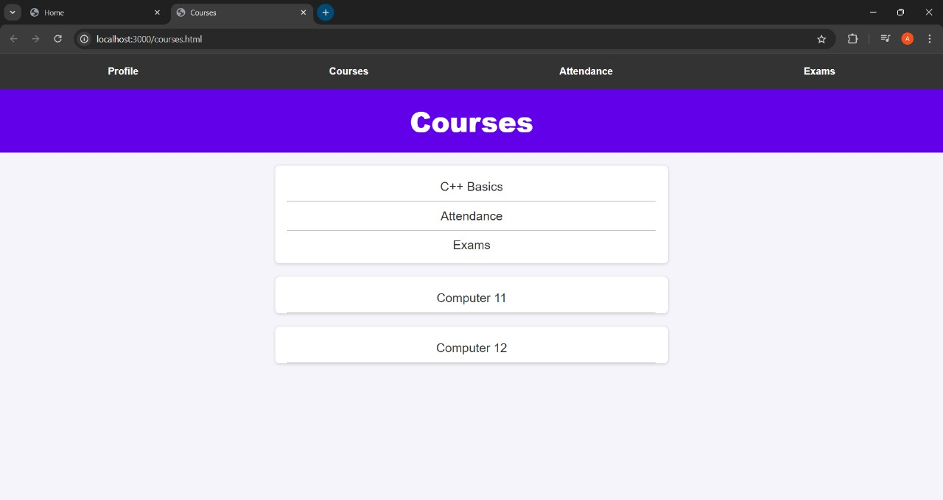
Features
Courses
Organize and view course materials.

Slide 4
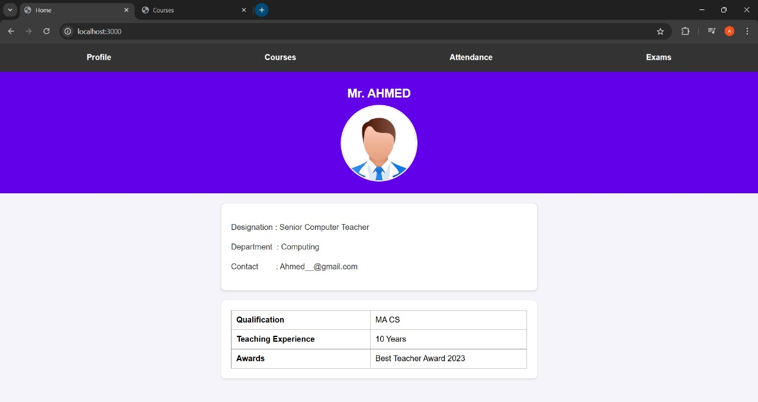
Profile
Manage personal and professional details.

Slide 5
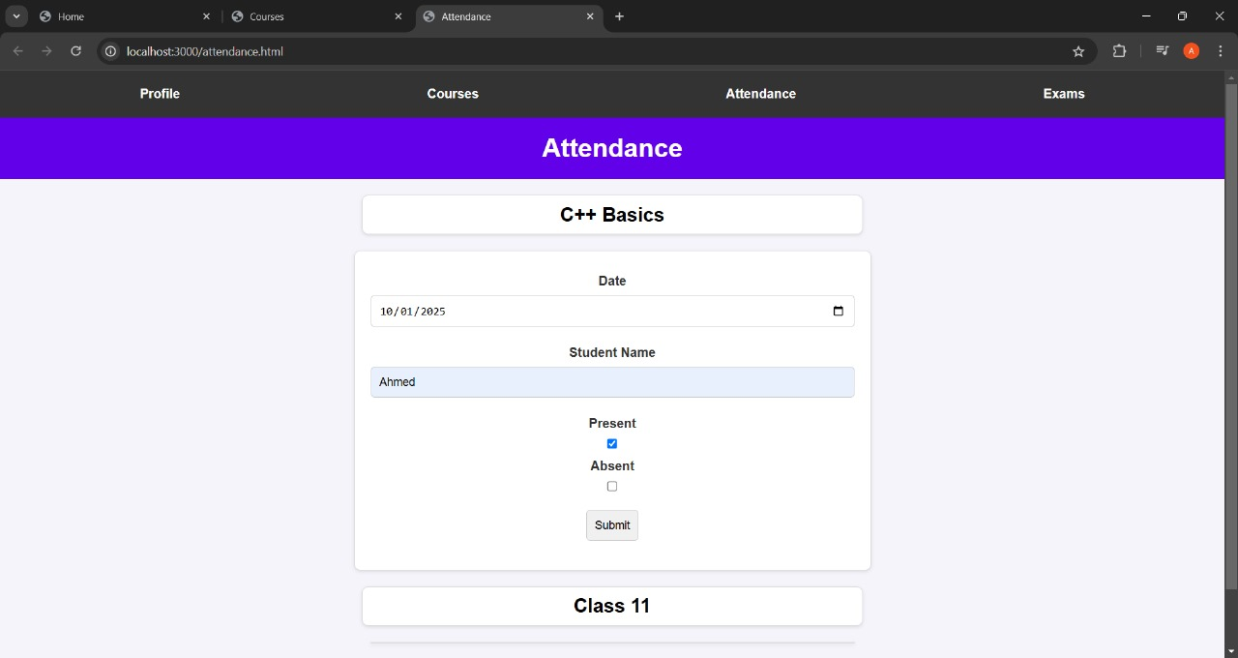
Attendance
Record, edit, and view student attendance.

Slide 6
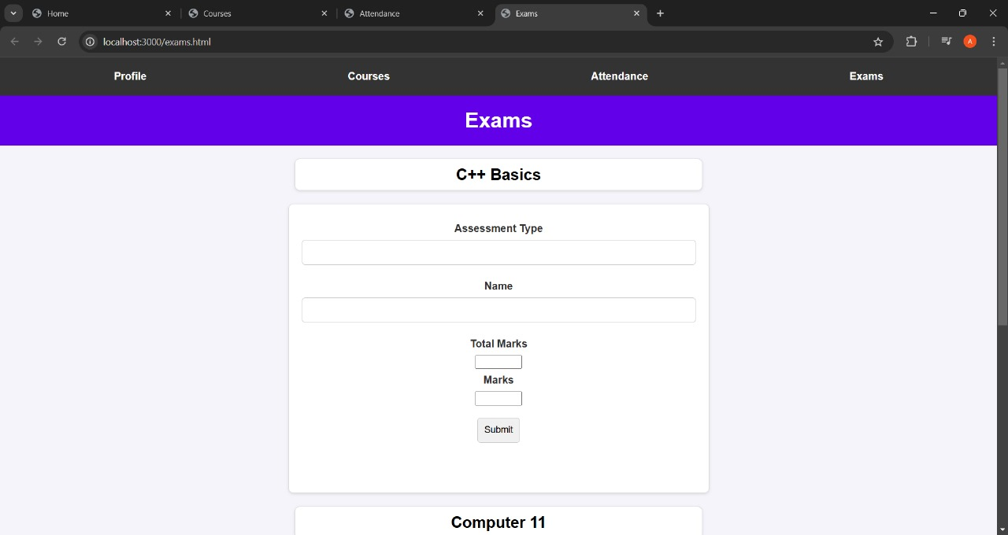
Exams
Manage exam schedules and marks.

Slide 7
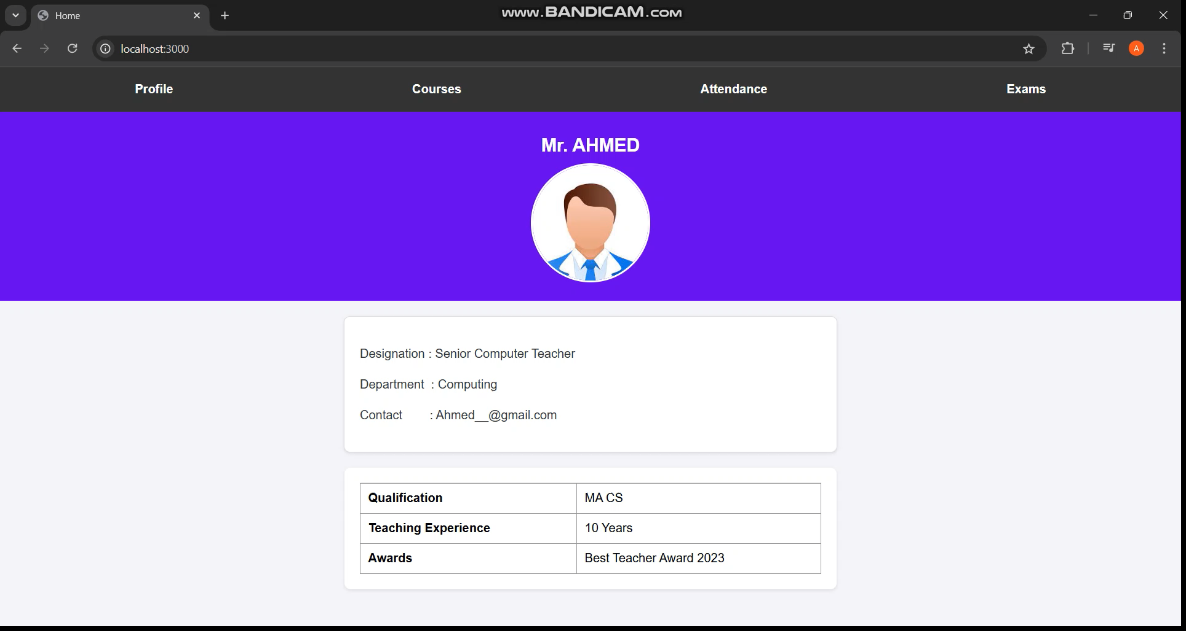
Functionality
Navigation
Smooth transitions between sections.
.

Slide 8
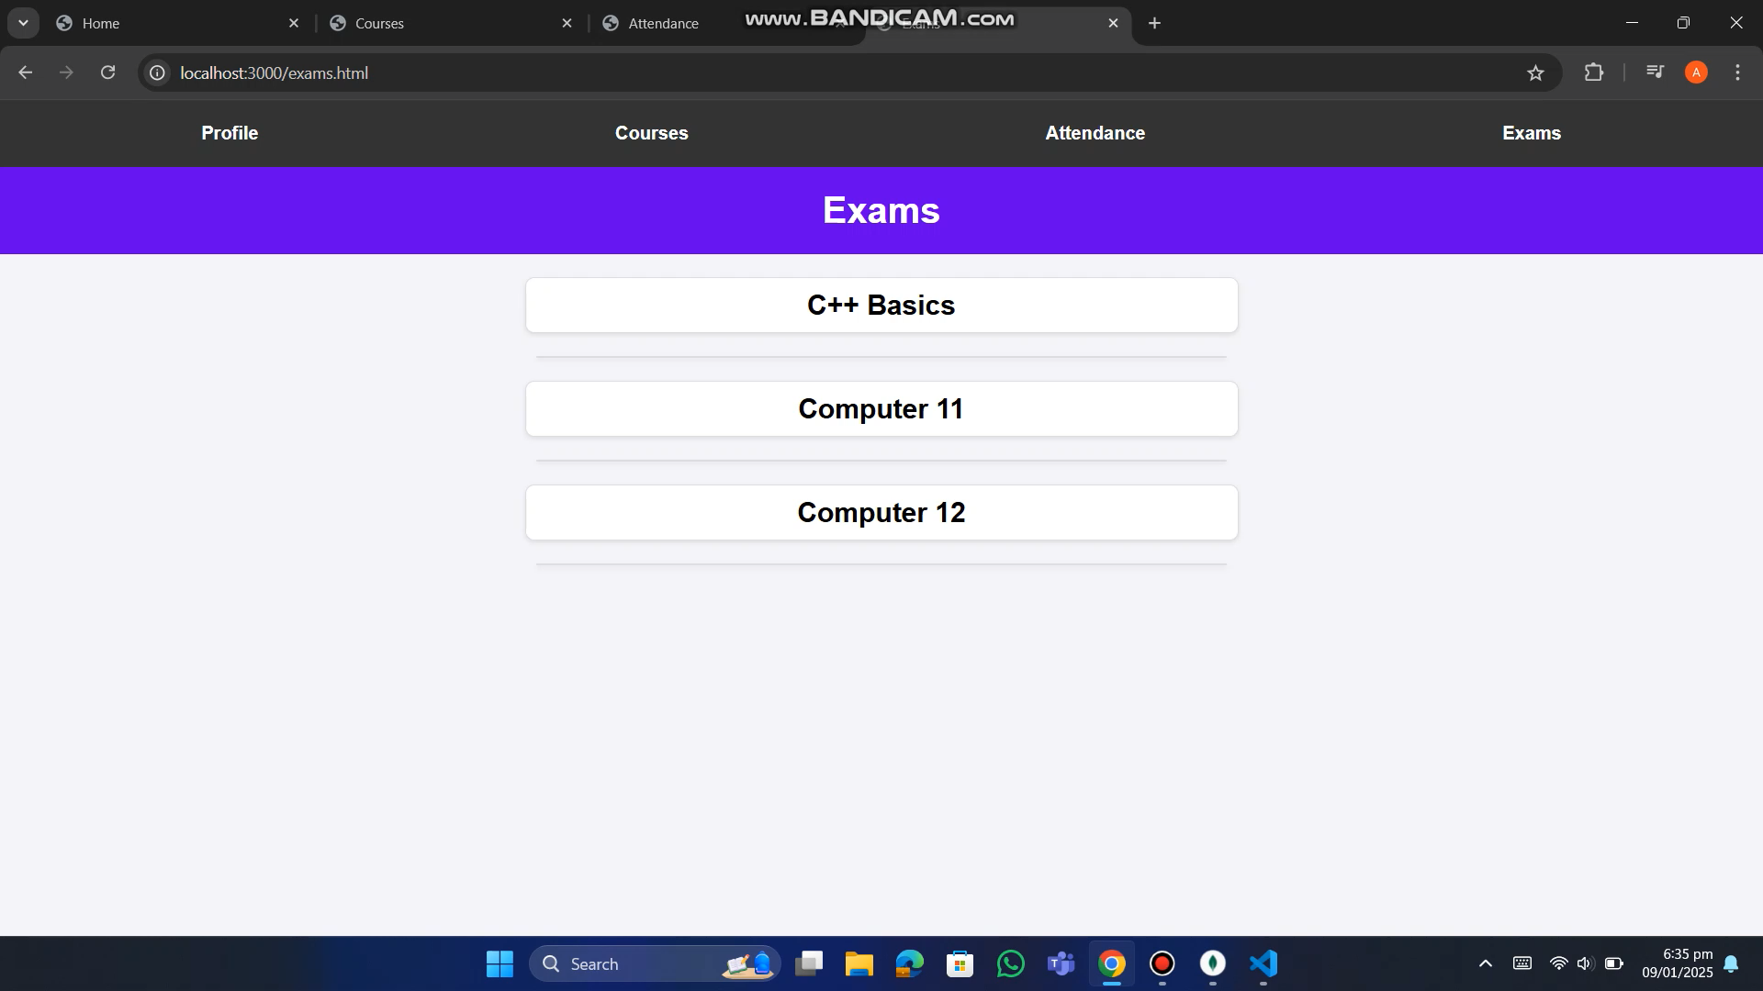
Functionality
Data Entry
.

Slide 9

HOVER EFFECTs

Slide 10
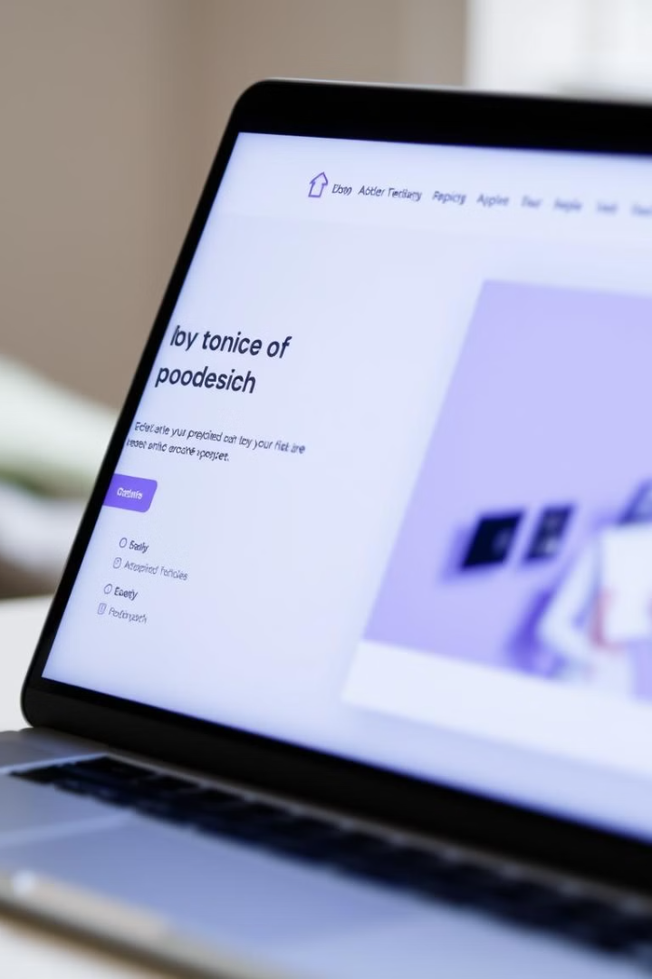
Design & Aesthetics
Layout & Structure
Color Scheme & Typography
User-friendly interface.
Professional and minimalistic design with purple theme
Navigation Design
Clear and logical navigation to all sections.

Slide 11

Languages/ Technologies Used
1
2
3
HTML
CSS
BACKEND
Structure of the website.
Styling and visual design.
Mongo DB and Node.js

Slide 12



Challenges Faced
Design & Layout
Connecting Backend

Slide 13
Key Learnings
Skills Gained
HTML + CSS
Brief knowledge on connecting database

Slide 14

Thank You

